Slide 1

Voice-Based Email Assistant
Hands-Free Email Interaction Using Speech Technologies
Intern Name : Vaghdevi Pappala
Mentor Name: Santhyia Krishnasamy

Slide 2



PROBLEM STATEMENT
Addressing Challenges in Traditional Email Interaction
Traditional email systems often present significant barriers to efficient and accessible communication. Our solution directly addresses these critical issues.
Manual Input Dependency
Accessibility Limitations
Demand for Voice Control
Heavy reliance on manual typing and screen interaction limits productivity and mobility for many users.
Visually impaired individuals face considerable challenges, restricting their independent access to email.
A growing need for hands-free, voice-driven email access to enhance convenience and multitasking capabilities.

Slide 3
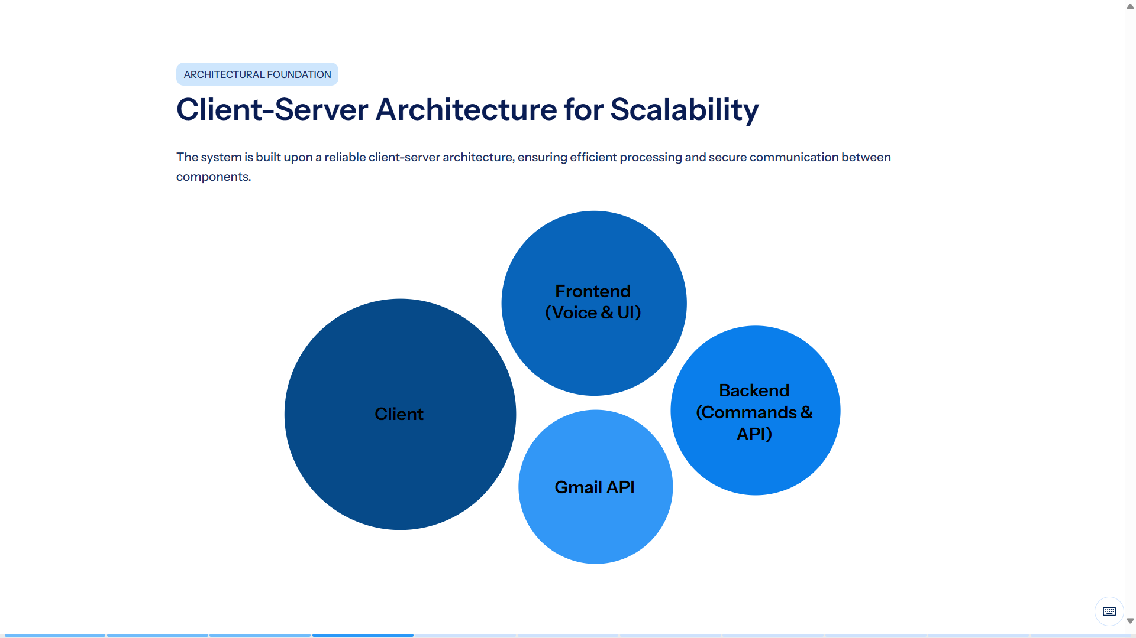

Slide 4







TECHNOLOGY LANDSCAPE
Core Technologies Driving the Assistant
We leverage a modern and powerful technology stack to deliver a high-performance and secure voice-based email experience.
Python
Flask Framework
Web Technologies
MongoDB
Primary language for backend logic and speech processing.
Lightweight web framework for building the backend API.
HTML, CSS, and JavaScript for the responsive frontend user interface.
NoSQL database for flexible data storage and session management.
Gmail API
OAuth 2.0
Web Speech API
Official API for secure and structured access to Gmail services.
Industry-standard protocol for authentication and authorization.
Used for Voice recognition and generation

Slide 5
Secure Face-Based Biometric Authentication
Advanced Face Recognition
Robust Build System with CMake
Enhanced Security and Accessibility
Our system implements advanced face recognition leveraging OpenCV’s powerful computer vision algorithms to verify users seamlessly and securely without passwords, ensuring a smooth and intuitive user experience.
We utilise CMake as a robust, cross-platform build system to efficiently manage and compile OpenCV and related libraries, guaranteeing smooth deployment across diverse operating environments and platforms.
This technology enhances security by matching unique facial features in real-time, significantly reducing risks of unauthorised access while simultaneously improving accessibility and user convenience for all.

Slide 6

CORE FUNCTIONALITY
Speech-to-Text (STT) Module: Voice to Command
The STT module forms the critical bridge between spoken language and actionable commands, enabling seamless voice interaction.
Audio Input Capture: Reliably captures spoken audio from the user's microphone.
Speech-to-Text Conversion: Converts the captured spoken commands into accurate text.
Primary Input Mechanism: Serves as the fundamental method for user interaction.
Hands-Free Interaction: Facilitates a truly hands-free experience for email management.

Slide 7




CORE FUNCTIONALITY
Voice Command Processing: Understanding User Intent
This module intelligently interprets transcribed text, translating natural language into specific email actions.
Text Input
Intent Identification
Receives text from the STT module.
Identifies the user's purpose and desired action.
Action Execution
Error Handling
Executes commands like reading or navigating emails.
Manages invalid or unrecognised commands gracefully.
By precisely identifying user intent, the system ensures that voice commands are translated into accurate and desired email operations.

Slide 8

CORE FUNCTIONALITY
Email Integration Module: Seamless Gmail Access
The Email Integration Module securely communicates with Gmail to retrieve and manage email content as per user commands.
Integrated with Gmail API: Utilises the official Gmail API for reliable and secure communication.
Secure Message Fetching: Fetches inbox messages securely, respecting user privacy and permissions.
Content Extraction: Extracts essential details like sender, subject, and email body for processing.
Indexed Email Ordering: Maintains a logical, indexed order of emails for easy navigation and retrieval.

Slide 9
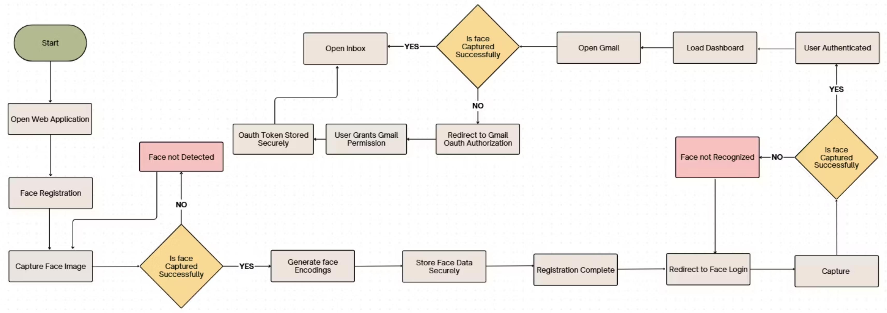
Work Flow Diagram

Slide 10
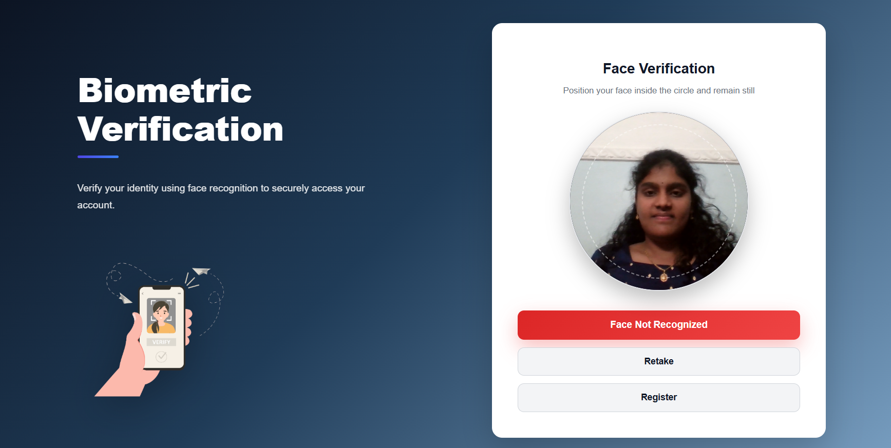
Results

Slide 11
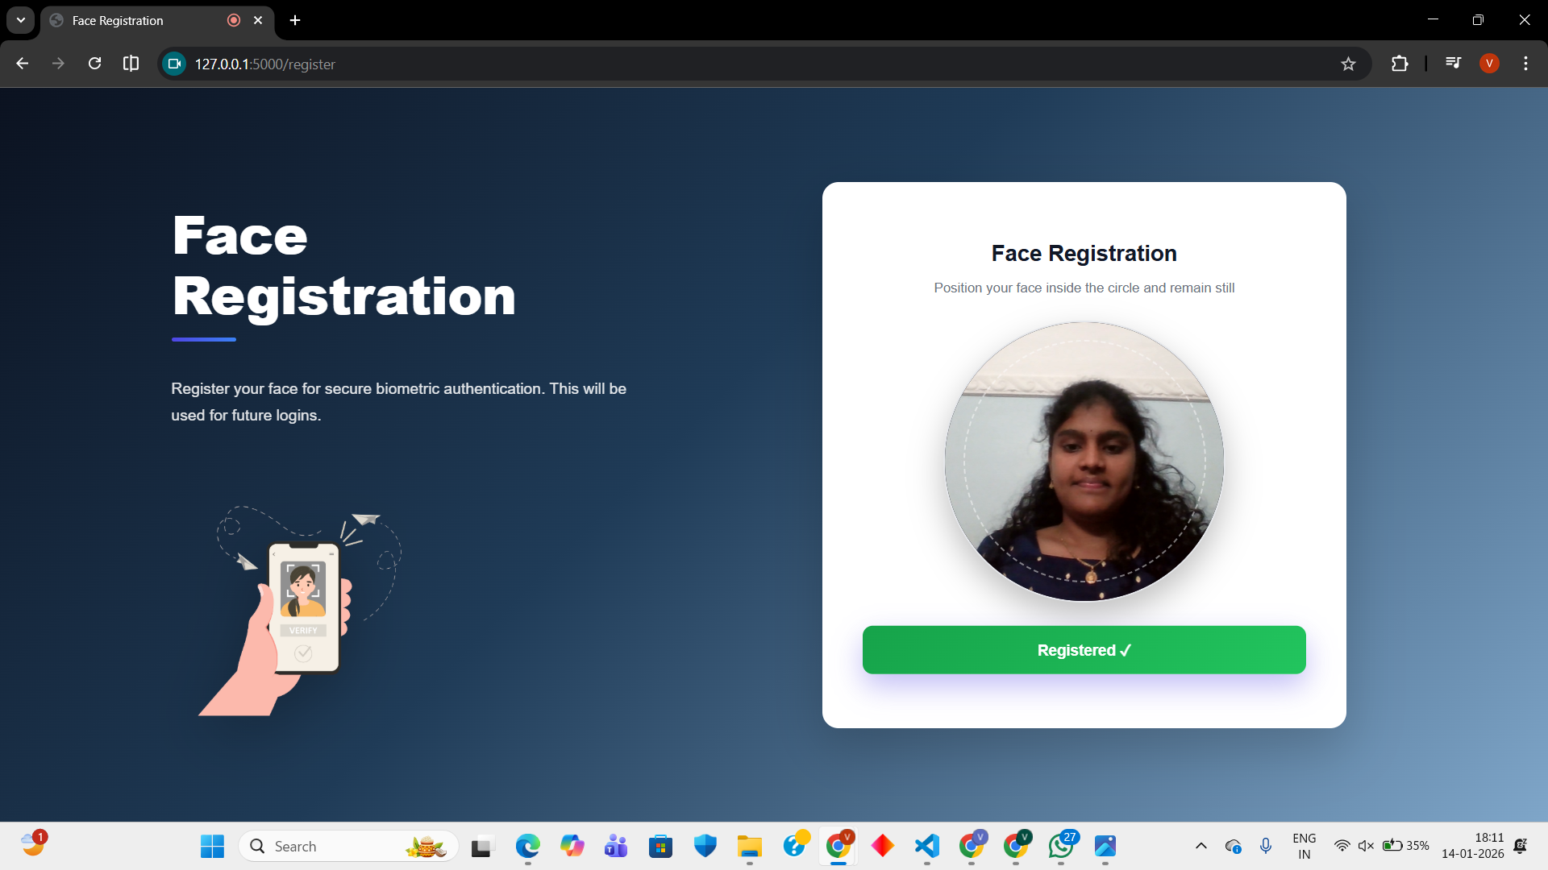

Slide 12
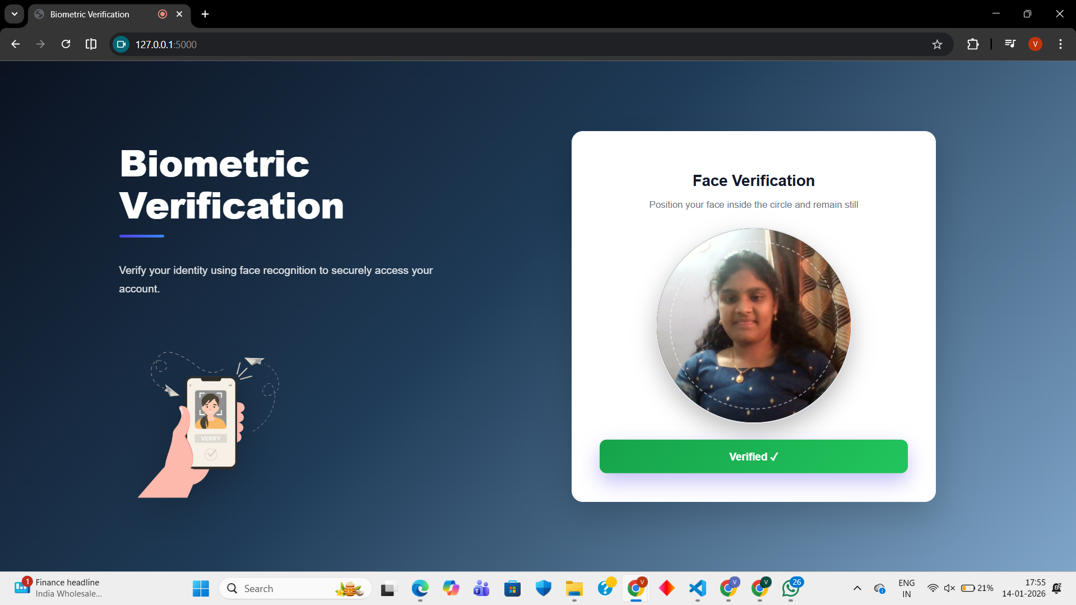

Slide 13
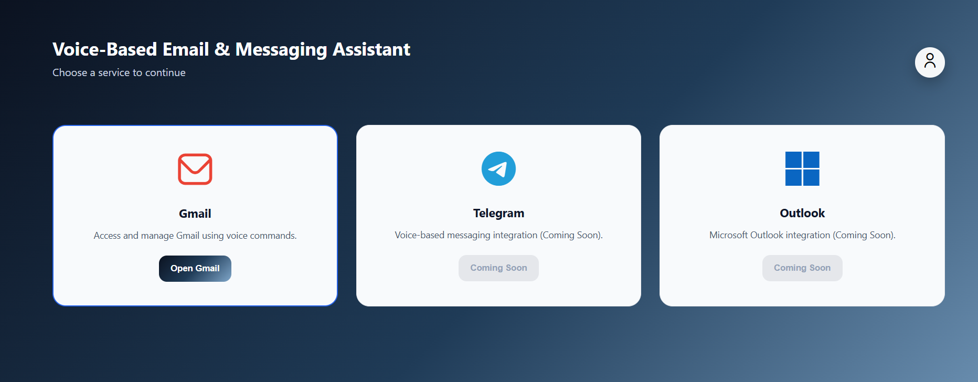

Slide 14
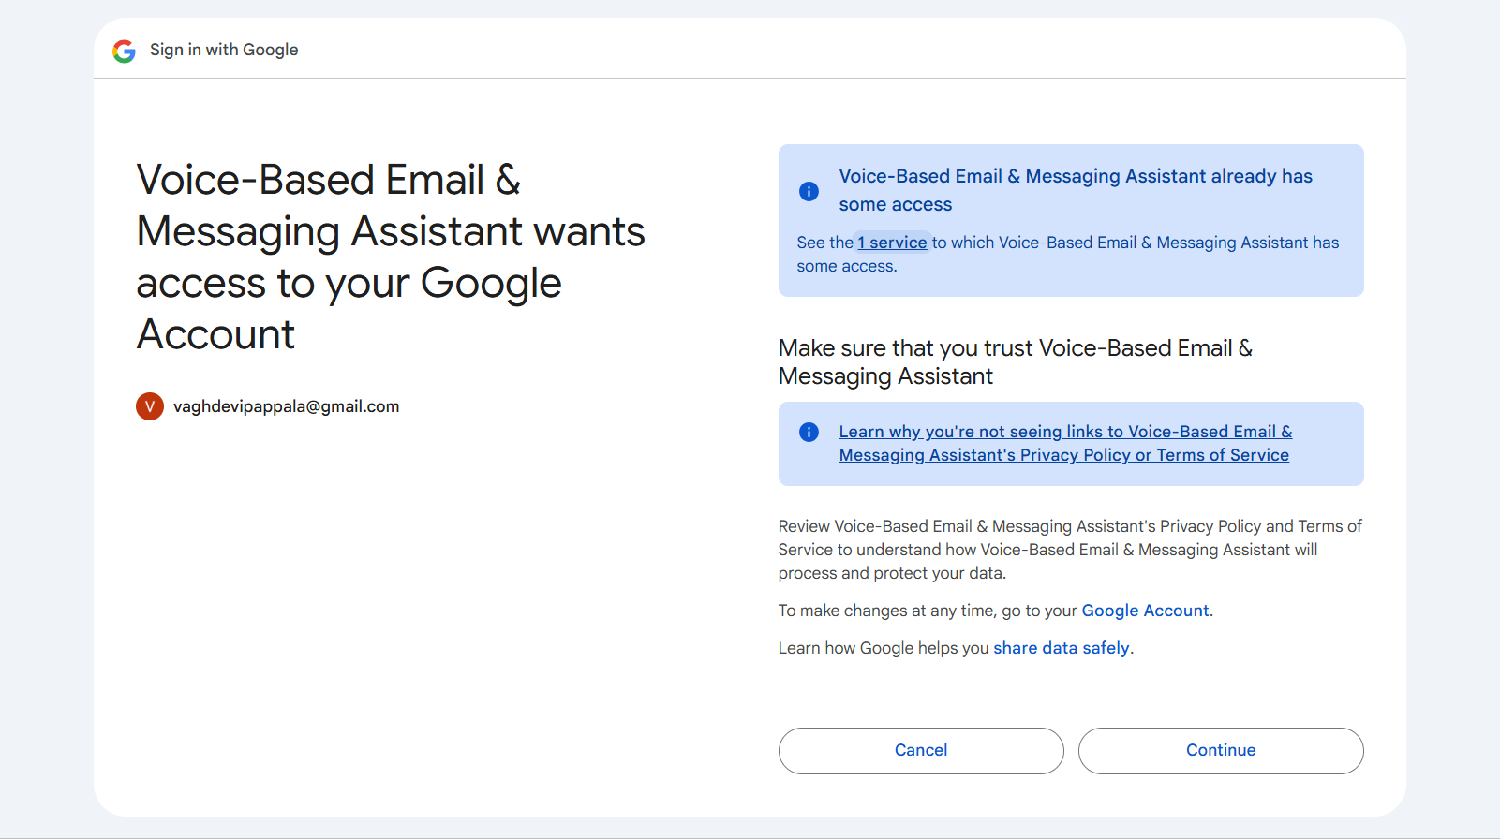

Slide 15
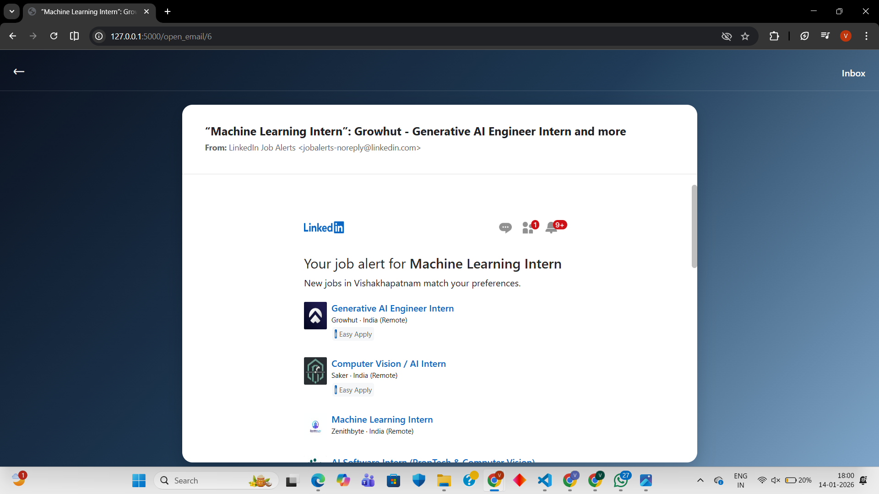

Slide 16
THANK YOU

